Slide 1
“HoUSING AUTHORITY FIRST” HOW PHA’s can HELP reducE homelessness THROUGH hOUSING FIRST EFFORTS
PSWRC-NAHRO Annual Spring Conference 2012
Monterey, California
Rob Pearson, Executive Director Housing Authority of the City of Santa Barbara
Tuesday, May 22, 2012

Slide 2
It is simply unacceptable for individuals, children, families
and our nation’s Veterans to be faced with homelessness in this country.
President Obama June 18, 2009

Slide 3
The setting… Santa Barbara Community
200,000 population – Santa Barbara south coast
$800,000 median home price
$74,000 family of 4 median income
Translates to one of lowest housing affordability indexes in the Nation
$1,550/month median 2-bedroom apartment rent
Estimated homeless population - 3,000 to 6,000

Slide 4
The setting…continued
County 2009 Report: Homelessness having $36 million per year financial impact—health care, criminal justice, social services, etc.
Past 30 years, over 600 downtown SRO’s lost due to redevelopment activity -- private demolition and conversion to tourist hotels
Annually, 30-40 youth age out of foster care in SB County and 65% have no place to live
32% of youth emancipating in SB County are homeless within 6 months (2007 Grand Jury Report)

Slide 5
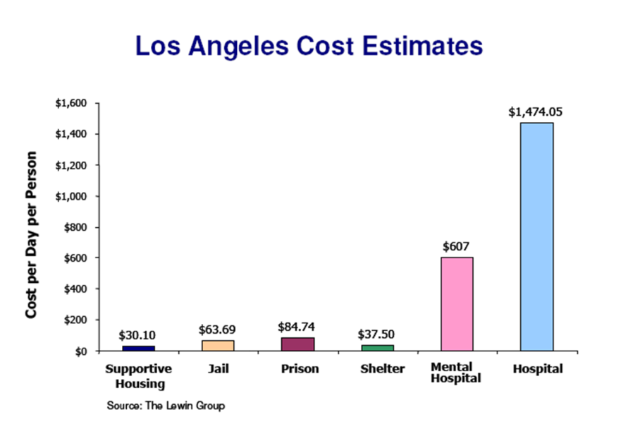

Slide 6
Resources HACSb has Committed to reducing homelessness
Created development targeted for permanent supportive housing for the homeless
Section 8 – Housing Choice Voucher Program
Preferences
Set-asides
Project Basing Section 8 for other housing providers serving the homeless
Shelter Plus Care
Partnerships with other organizations to ensure that we house those most in need and reduce homelessness
Lead Agency on local 100K HOMES Campaign (You can do this too!)

Slide 7
Types of housing and design elements that work best for “Housing First” projects?
Studios, one-bedroom units, SRO* units
*An SRO unit one which has one room that can include separate bathroom and/or separate kitchen. Access to a shared kitchen and/or a shared bathroom required if they are not included within the unit.
For tax exempt bond and LIHTC financing, units must include bathroom and kitchen. Kitchen definition must comply with higher of local building codes or HUD Housing Quality Standards

Slide 8
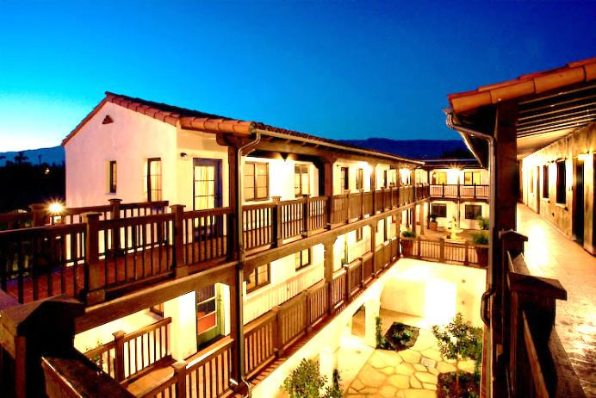
El Carrillo – 315 W. Carrillo Street 61 Studio Units—HA New construction—circa 2006 Permanent supportive housing for homeless or those at risk of homelessness

Slide 9
El Carrillo A Collaborate Textbook for Permanent, Supportive Housing
Housing Authority of the City of Santa Barbara
PathPoint
Santa Barbara County Alcohol, Drug, and Mental Health Services

Slide 10
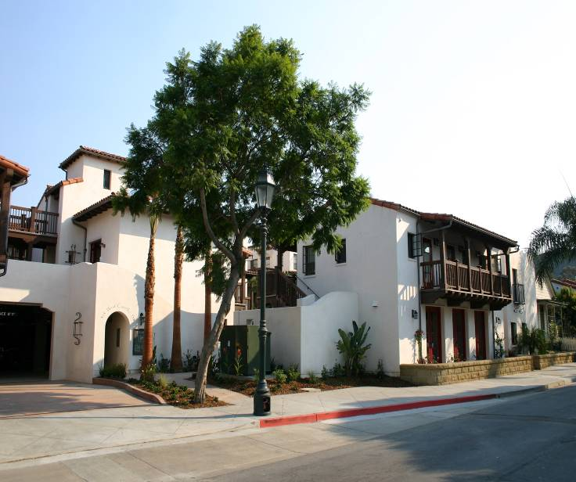

Slide 11
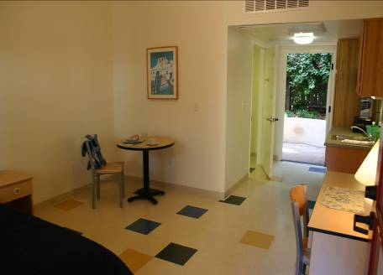
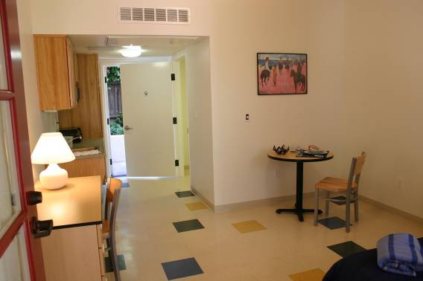
Each studio spacious at 254 sq. ft.
Ample light and air circulation given front and rear doors and front window
Most units feature small balcony
All units have handicap-accessible bathroom and kitchenette
All units fully furnished including bedding, towels, toiletries, lamps, etc. “Adopt-A-Room” campaign

Slide 12
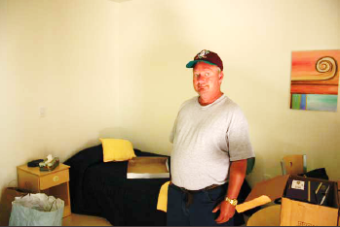
I have been homeless since March 2005.
Having a home again I can not put into
mere words my feelings and thoughts;
but it seems like I have survived my
own personal holocaust.
– Joseph

Slide 13
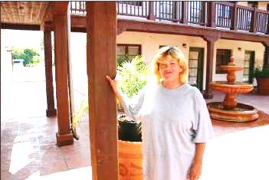
It’s difficult to put into words the happiness that surrounds El Carrillo!
Thank you so much for the opportunity to become a viable part of society again to feel like a person who can now work and come home to her own light switch. I can come home and tell myself, “Good job!” instead of getting off of work and having no place to go other than my car. I am so very thankful for this opportunity to be a whole person again. There’s no place like home for my
weary soul.
– Cathy

Slide 14
55 studios & 1 two-bedroom manager’s unit
HA New construction/Low Income Housing Tax Credit project
Permanent supportive housing for youth aging out of foster care, homeless & very low income downtown workers
Completed Construction – March 28th.
100% Occupied on March 31st

Slide 15
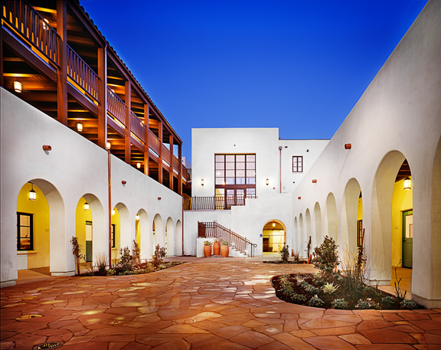

Slide 16
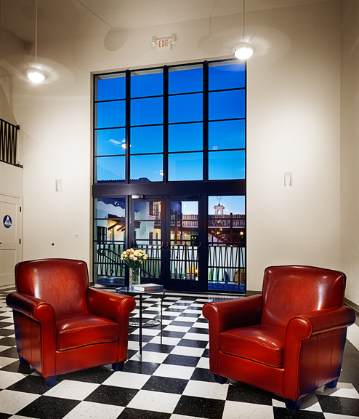

Slide 17
Resident profile
19 Downtown Workers – must work within designated area determined by the City – limit traffic impacts
14 Transition Aged Youth – must have exited the foster care system within last 6 years and under 24 years of age, Section 8 FUP Vouchers for 18 months
22 Special Needs
5 transitioning from El Carrillo, HACSB’s 61 unit supportive affordable housing for the homeless
5 graduating from 18-month dual diagnosis program for formerly homeless (Hotel de Riviera)
5 from local homeless shelters (Casa Esperanza, Willbridge)
6 from HACSB waiting list, disabled

Slide 18
March 26, 2011
Rooms adopted: $350/each
150 community volunteers
55 rooms furnished with 56 items each--linens, flatware, dishes, cookware, and donated art
Adopt-a-Room Day

Slide 19
Artisan Court studio unit

Slide 20
Images of studio units

Slide 21
The goal of services
Create Culture of Recovery (from culture of homelessness)
Once housed, different culture required for sustainability
Focus on social valorization
Build Community at Artisan Court
Support Individual Needs
Variety of program models available on-site, either through PathPoint, Youth & Family Services or local agencies invited to offer programs on-site

Slide 22
“I’ve got everything I ever wanted, a bed…everything. This means a brand new beginning and a new future for my life. I’ve been outside for forty years…this is the beginning of beautifulness. This is mine, this is mine. I can’t believe I have a place to go tonight.”—Mike

Slide 23
“This means a start for me. Anything before this day doesn’t mean anything. Today is my new year!”—Le’Andra

Slide 24
Housing Authority Tools and Developments Promoting “Housing First”
Housing Choice Vouchers (aka Section 8) – Project Based and Tenant Based
Important and often needed revenue stream for actual projects
VASH Vouchers
Local preferences targeting the homeless / Create local preference for those on the Vulnerability Index List
Shelter Plus Care & and Other CoC grants programs
HOME--Implementing a HOME funded Tenant Based Rental Assistance Program targeting the homeless
Sonoma County example
Current effort with City of Santa Barbara
Transitional Assistance Program (TAP)
Ensuring appropriate outreach and support to homeless
Actual projects that are or can be Housing First models

Slide 25
Survey Week – what we did
Over 500 volunteers across the county attempted to survey everyone found on the streets and in the shelters
Gave them an option to complete the Vulnerability Index Survey

Slide 26
Common Ground Santa Barbara Results
1,536 people encountered
1,143 Surveys Completed
932 (82%) vulnerable with high mortality risk

Slide 27
Living Situation
Reported Staying | Count | % of eligible surveys
Street | 270 | 29%
Vehicle | 138 | 15%
Shelter | 291 | 31%
Doubled Up | 46 | 5%
SRO | 35 | 4%
Transitional | 117 | 13%
Other | 22 | 2%
Unknown | 13 | 1%

Slide 28
General Demographics…cont.
Average Age | 41
Oldest Individual Contact | 78
Youngest individual contact | 12
Average Time Homeless | 7 years
Foster Care | 16%
* Cost of Incarceration: Jail (daily rate: $77/day with average length of stay of 20 days. Prison: Average cost per prisoner per year $45,000. Average length of stay 15 months.
Incarceration Type | % of participants | Cost *
Jail | 77% | $1,111,880
Prison | 24% | $12,487,500
Total Cost of Incarcerations * |  | $13,599,380
* Source: CA Dept of Corrections and Rehabilitation and Bureau of Justice Statistic

Slide 29
Sub-population: Family Survey Demographics
Number of Total Surveys | 134
Number Vulnerable | 130 (97%)
Average Time homeless | 1.8 years
Average Age of HOH | 32.9
Gender of Head of Household Males Females | 27 (20.77%) 103 (79.23%)
Currently Pregnant | 10 (7.69%)
Adult reported victim of sex abuse as a child | 46 (35.38%)
Victims of Domestic Violence | 69 (53.08%)
Victim of Violent Attack since homeless | 16 (12.31%)
Number of Children | 221
Children < 1 year old | 14
Children ages 1 to 5 | 92
Children w/ serious medical condition | 16

Slide 30
Sub-Population: Family Surveys…cont.
Survey Location | Count
Cuyama Valley | 3
Isla Vista | 2
Lompoc | 18
Santa Barbara | 30
Santa Maria/Orcutt | 77
Total | 130
Currently Staying | Count
Doubled up | 22
Other | 5
Shelter | 34
SRO | 12
Streets-Outdoors | 3
Transitional | 47
Vehicle | 7

Slide 31
All Conditions

Slide 32
Findings
High self reported rates of mental illness and substance use
Significant levels of disease burden, both chronic conditions and infectious diseases
High levels of illnesses specific to homelessness, such as weather related impacts and exposure to violence
Findings correlate with Homeless Death Review Report as well as national statistics.
Total reported Emergency Room visits of 326 and hospitalizations of 405 annually, with an estimated cost of almost $3 million

Slide 33
We have already housed 56 from the Vulnerability Index…and we have a very tight rental market!

Slide 34
What we need to reach our 100 housed goal:
Landlord community - must commit units and preferences for those most at risk.
Service Providers must commit to working together – combining small resources will translate into larger resources.
Faith Community – can help with the 100 Housed project and empowerment committees
Business Community – stay involved and be a part of the solution offer resources and assistance.

Slide 35
Final Thought
If we are to we have the word “Authority” in our name – then we must be the AUTHORITY with regard to housing the most vulnerable – this includes homeless individuals and families.

Slide 36
Final Thought…continued
Possible Responses by Housing Authorities:
Commit a portion of the PHA’s Voucher allocation through preferences and/or set-asides
Project Base vouchers with sponsors/landlords serving the homeless
Join us as a leader in our community/partner with us to make a demonstrable difference in reducing homelessness – The PHA will be a super hero – saving lives
JOIN and endorse the 100K HOMES Campaign – put the vulnerability index survey to work in your community
Recognize HUD’s commitment to new resources to end homelessness and their expectation for PHA participation

