Slide 1
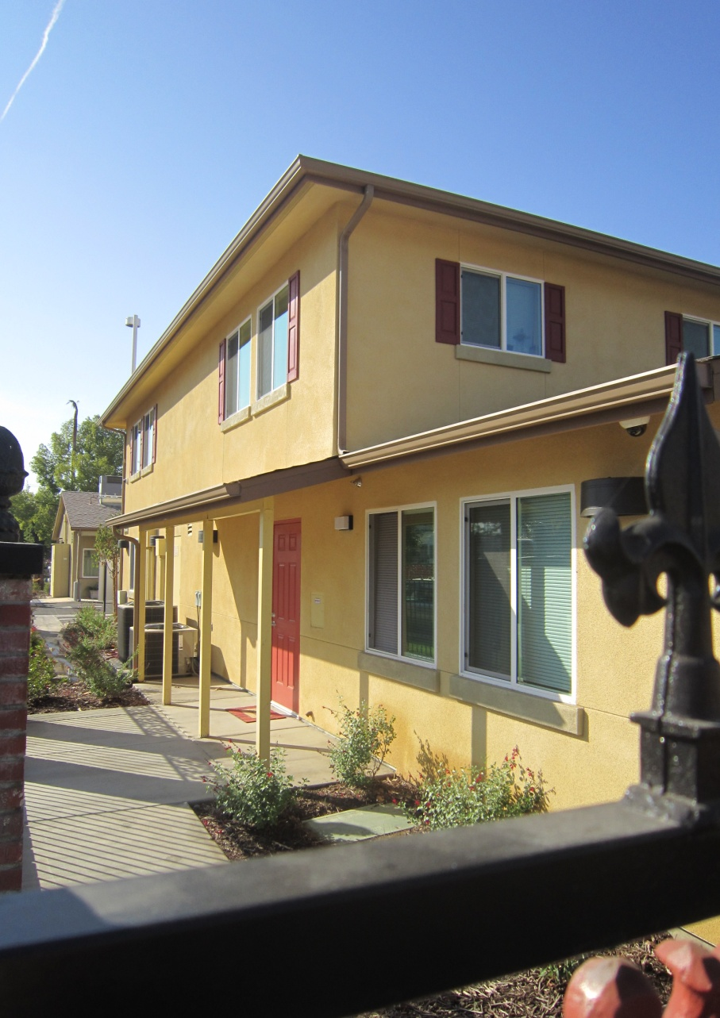
Connecting Housing Authorities with Continuums of Care
Angie Nguyen, Assisted Housing Manager
Fresno Housing Authority
Homeless Initiatives
May 22, 2012
Notes:
Intro slide

Slide 2

The Fresno-Madera CoC
Active since 2001
Increase community awareness
Develop & implement strategies
Approx. 30 agencies from various public, private, & non-profit sectors
  8 - ES
  1 – SH
  20 – TH
  15 – PSH
  Total of 1,856 beds

Slide 3
Current Reality
4,378
Total Homeless Population
3,271
Unsheltered Homeless
1,107
Sheltered Homeless
616
Increase in
Total Homeless since 2011
= 200 individuals
Source: FMCoC Point In Time Count 2011

Slide 4
2011 PIT Subpopulations
Type of homeless | Number
Chronically homeless individuals | 654
Chronically homeless families | 182
Homeless with severe mental illness | 259
Homeless with chronic substance abuse | 1,409
Homeless veterans | 590
Homeless victims of domestic violence | 537
Homeless with HIV/AIDS | 38
Homeless under the age of 18 | 11
Source: FMCoC Point In Time Count 2011

Slide 5
Snapshot of Persons Served - CoC 2011
Average Age | 48
Oldest Person | 78
Youngest Single Person | 18
Average Length of Homelessness | 5 years
Former Foster Care | 15%
Children under age 5 | 142

Slide 6
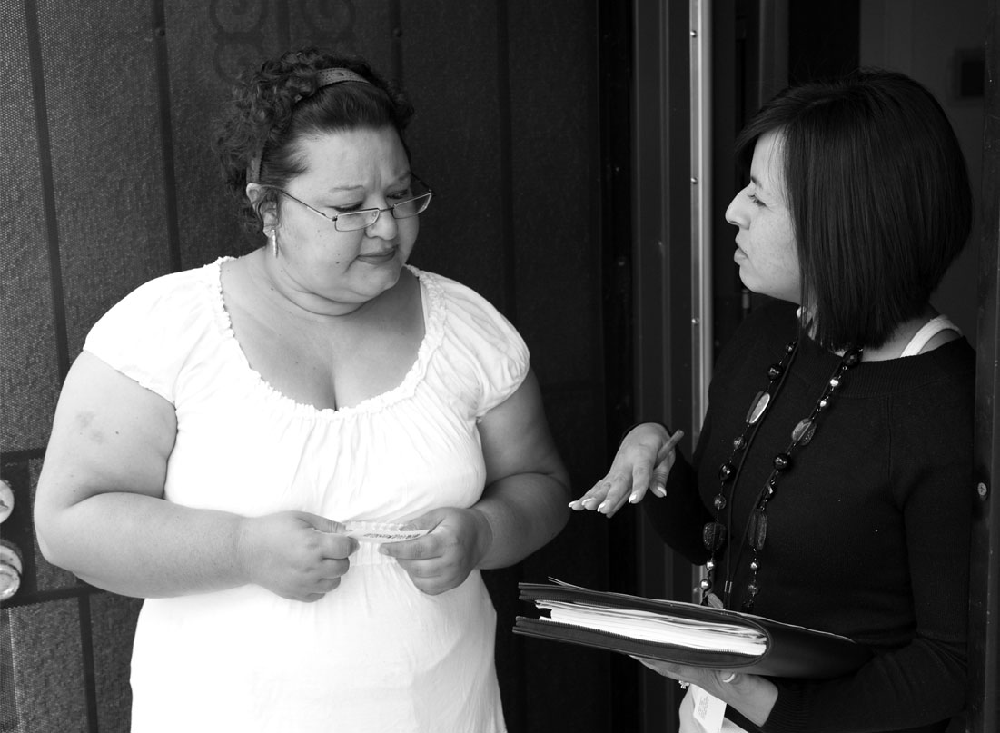
Homeless Programs
& Services

Slide 7
Homeless Programs & Services
De-Encampment partnership with the City of Fresno
  July 2009
  January 2010
  November 2011
Project P4/Vulnerability Index
  July 2011 – 279 surveys
  September 2011 – 19 surveys
  November 2011 – 136 surveys
  Vulnerable housed YTD – 59 persons

Slide 8
Homeless Programs & Services
Homeless Prevention and
Rapid Re-Housing Program successes:
  238 people housed
Shelter Plus Care: 160 Certificates
Veteran’s Affairs Supportive Housing:145 vouchers
Fresno First Steps Home: 40 people housed
$800,000 in cash investment from
Fresno Housing Authority
Renaissance PSH – Mixed financing, 118 PBV, & Property Management
PSH Partnerships - $1.4mil

Slide 9
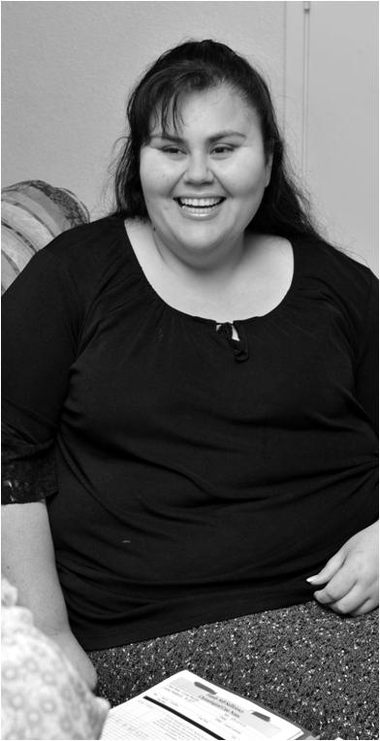
Lead Agency
POC for all CoC-related matters
Lead applicant for CoC Homeless Assistance competition
Coordinates the Annual/Biennial sheltered & unsheltered PIT counts
HMIS Administrator
  AHAR, HDX, HUD data updates
100,000 Homes Campaign
Current CoC Chair
  HEARTH Act- UFA

Slide 10

The Future

Slide 11
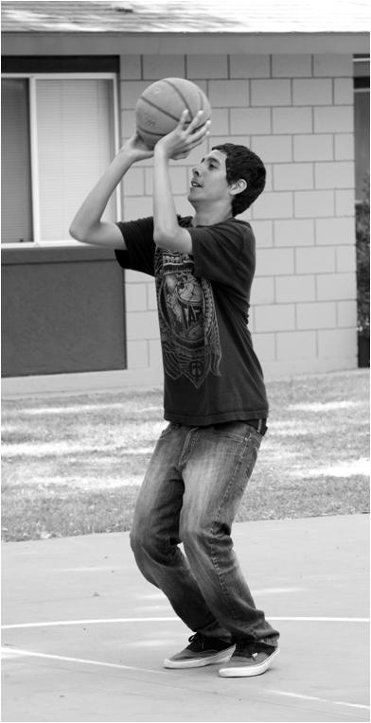
Where We Are Headed
Building a strong public will:
Increasing coordination of
“wrap around” services
Managing a data system
that will drive future investment
and service delivery improvement
Developing a centralized intake system

Slide 12

Why Does it Matter?
There is no single solution
Emphasis on performance
Reduces drain on public resources
Supports the notion that everyone
in our community deserves a safe, affordable place to live
When residents thrive,
our community thrives

Slide 13
Thank you
Presented by:
Angie Nguyen, Assisted Housing Manager
Fresno Housing Authority
1331 Fulton Mall
Fresno, California 93721
(559) 443-8439
anguyen@fresnohousing.org

